Slide 1
TYPES OF INHERITANCE IN C#

Slide 2

TYPES OF INHERITANCE IN C#

Slide 3
SINGLE INHERITANCE
It is the type of inheritance in which there is one base class and one derived class.

Slide 4
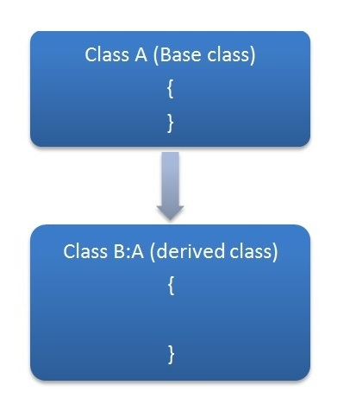
SINGLE INHERITANCE

Slide 5
HIERARCHICAL INHERITANCE
This is the type of inheritance in which there are multiple classes derived from one base class.
This type of inheritance is used when there is a requirement of one class feature that is needed in multiple classes.

Slide 6
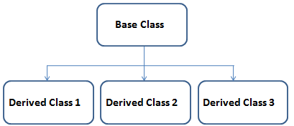
HIERARCHICAL INHERITANCE

Slide 7
multilevel INHERITANCE
When one class is derived from another derived class then this type of inheritance is called multilevel inheritance.

Slide 8
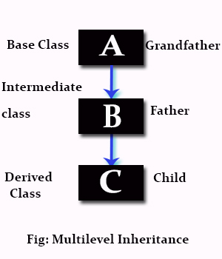
multilevel INHERITANCE

Slide 9
Multiple inheritance using Interfaces

